Slide 1
Part 5: Build your own Bot

Slide 2
15 mins Exercise
Build a Bot

Slide 3
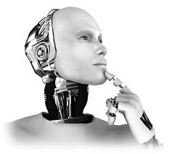
Bots
What are bots?
What they are/aren’t
Why bots?
Examples of Bots
Basic Bots
Question and Answer bots with QNAMaker
Advanced Bots
How to Build bots
How they work
Bot Framework (Bot Service, Bot Builder SDK)
Lets build a bot!

Slide 4
Bots
What are bots?
What they are/aren’t
Why bots?
Examples of Bots
Basic Bots
Question and Answer bots with QNAMaker
Advanced Bots
How to Build bots
How they work
Bot Framework (Bot Service, Bot Builder SDK)
Lets build a bot!

Slide 5
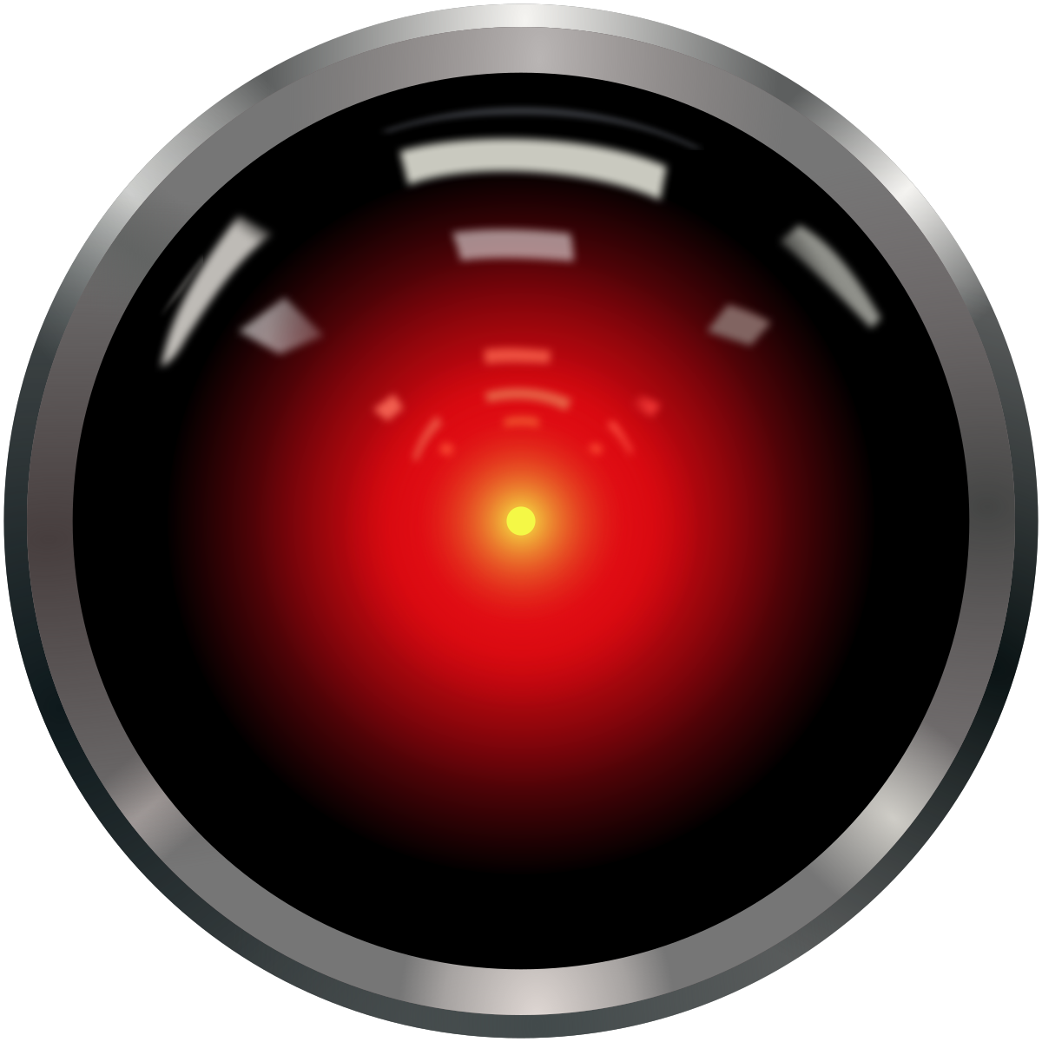
What AREN’T bots…
Bots are not…
AI only
Text interfaces only
Language Processing only
Bots are… apps with a new interface

Slide 6
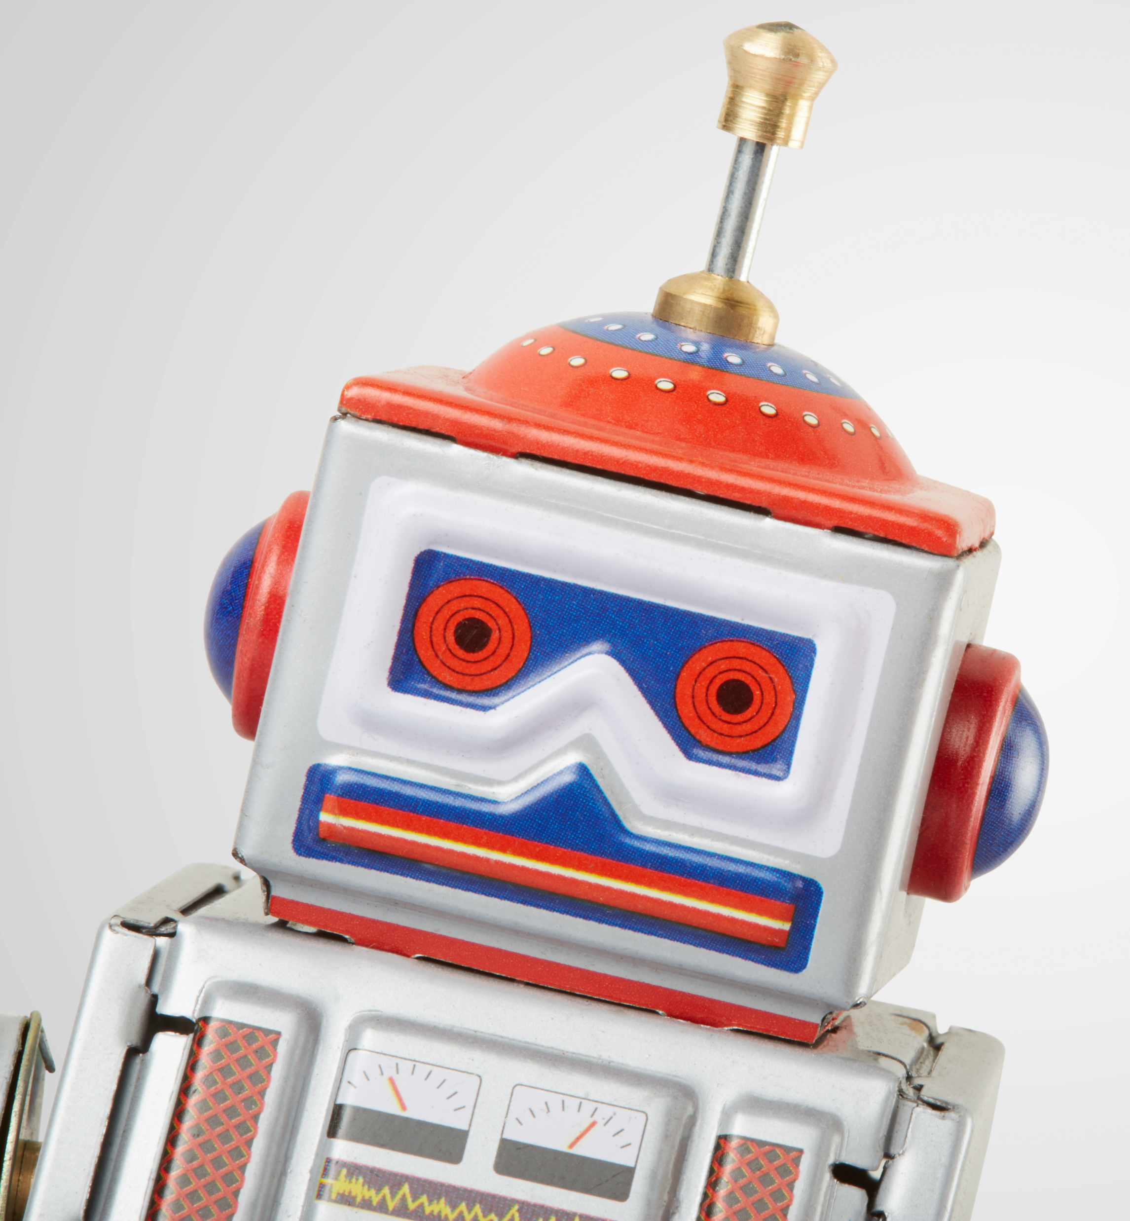
What IS a bot?
An application that performs one or more automated tasks..
Bots uses conversation as the interface for both internally-facing (students/employees) and externally-facing (guests/customers) scenarios.
Help solve problems.

Slide 7
Bots will save you money! Automate repetitive tasks, then hand off to humans
Reach users anywhere, on any platform or device
Engage with users in a natural way, conversationally and in context
Expose your services via messaging platforms, where users are already highly engaged
Improve user experience and reduce the need for human assistance
Why Bots?

Slide 8
Bots
What are bots?
What they are/aren’t
Why bots?
Examples of Bots
Basic Bots
Question and Answer bots with QNAMaker
Advanced Bots
How to Build bots
How they work
Bot Framework (Bot Service, Bot Builder SDK)
Lets build a bot!

Slide 9
Examples of Bots
Internal Bots
Experiment and Learn
Simple Customer Bots
Unauthenticated Services
Advanced Bots
Authenticated Services
Internal Knowledge
Take existing FAQs and empower students/staff to provide self-serve knowledge via Bot.
General Enquiries
Handle basic user enquiries traditionally hidden in FAQs.
Account Enquiry
Handle enquiries that require identification of the customer
(i.e., account balance enquiry)
IT/Student Helpdesk
Report an IT problem and check the status. Bot can provide self-help and escalation to engineer if required.
Appointment Booking
Handle simple “anonymous” tasks via chat (i.e., booking an appointment)
Make Payment
Perform actions that require a user to be authenticated and authorized, e.g. make payment to predefined payee.
Smart Document Agent
Search of relevant documents based on the user’s needs.
Complex Enquiries
For requests that a Bot cannot complete hand off to a human agent.
Retail-bot
Send a customer with a new device to a stall to help them set up their services.

Slide 10
Bots
What are bots?
What they are/aren’t
Why bots?
Examples of Bots
Basic Bots
Question and Answer bots with QNAMaker
Advanced Bots
How to Build bots
How they work
Microsoft Bot Framework (Bot Service, Bot Builder SDK)
Lets build a bot!

Slide 11
How to build a bot: design
Valuable
Address a real (or latent) need or solve a problem
Accessible
is more easily accessible and available when and where the user needs it
Effective
Help meets the need more efficiently, easier, and faster than alternative experiences

Slide 12
How to build a bot: tools
Microsoft Bot framework
Bot Builder SDK
Build and connect intelligent bots
Powerful, easy-to-use framework
Start quickly with samples and templates
Open source on GitHub
Azure Bot service
Accelerated development
Give your bot intelligence with Microsoft Cognitive Services
Engage your audience, wherever they are
Channels
Connect your bot to Microsoft Teams, Skype, Cortana, or other channels
Configure channels via Microsoft Azure Bot Service
User discovery of bots

Slide 13
How to build a bot: intelligence
ML
Language Understanding Intelligent Service
Teach your apps to understand commands from your users
Cognitive Search
Integrate search into a conversational experience
QnA Maker
Distill information into conversational, easy-to-navigate answers
Your Own Machine/Deep Learning Model
Link data sources and model to suit your business processes
Bing Speech API
Convert speech to text and back again, and understand its intent
Speaker Recognition Give your app the ability to know who's talking
Translator
More easily perform speech and text translation
Custom Speech Service
Fine-tune speech recognition for anyone, nearly anywhere

Slide 14
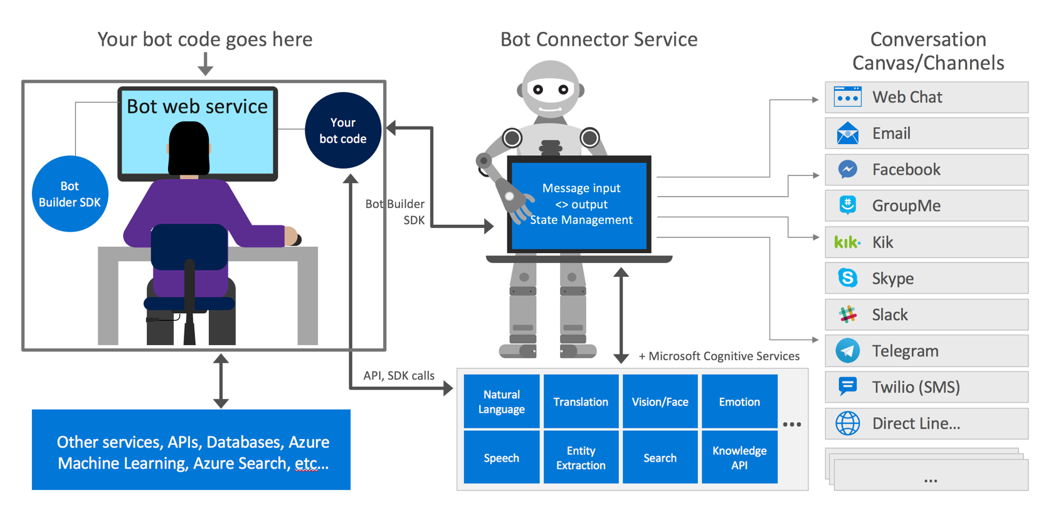
Anatomy of the bot framework

Slide 15
Bots
Let’s build a bot!
Step 1: Create your QnAMaker Service on Azure
Step 2: Create your Knowledge Base on QnAMaker
Step 3: Create and publish your bot to the world!
What are bots?
What are they
How do they work
What are the type of bots?
Basic Bots
Question and Answer bots with QNAMaker
Natural Language understanding bots with LUIS
Complex Bots
How to Build bots?
Bot Framework (Bot Service, Bot Builder SDK)
Lets build a bot!

